Slide 1

Housing Market Prediction in King County, USA
A Data Analysis for Real Estate
Investment Trust

Slide 2

Outline
Introduction
Tools Used for Data Analysis
Modules of Data Analysis
Conclusion
Recommendations

Slide 3
Introduction
Background
The Trust intends to invest in the residential real estate.
Purpose
Determine the market price of a house.
Analyze and predict housing prices using attributes or feature.
Tools used
Jupiter Notebook
Python
Python libraries:
Pandas
Matplotlib
Numpy
Seaborn
Scikit-learn
PowerPoint

Slide 4

Introduction
Modules
Data preprocessing
Data wrangling
Exploratory Data Analysis
Model Development
Model Evaluation and Refinement
Conclusion
Summarize the results and key patterns
Recommendation
Suggestions for Real Estate investments

Slide 5
Module 1: Data Preprocessing
Variable | Description
id | A notation for a house
date | Date house was sold
price | Price is prediction target
bedrooms | Number of bedrooms
bathrooms | Number of bathrooms
sqft_living | Square footage of the home
sqft_lot | Square footage of the lot
floors | Total floors (levels) in house
waterfront | House which has a view to a waterfront
view | Has been viewed
condition | How good the condition is overall
grade | overall grade given to the housing unit, based on King County grading system
sqft_above | Square footage of house apart from basement
sqft_basement | Square footage of the basement
yr_built | Built Year
yr_renovated | Year when house was renovated
zipcode | Zip code
lat | Latitude coordinate
long | Longitude coordinate
sqft_living15 | Living room area in 2015(implies-- some renovations) This might or might not have affected the lotsize area
sqft_lot15 | LotSize area in 2015(implies-- some renovations)
Import the dataset
Data includes information of homes sold in King County between May 2014 and May 2015.
Attributes of dataset →
Generate a statistical summary of the dataframe

Slide 6

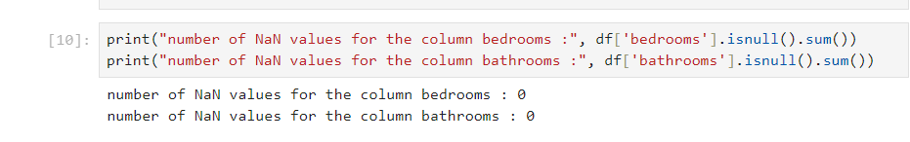
Module 2: Data wrangling
Remove redundant columns
Find missing values
Replace missing values
Check if there is a missing value

Slide 7
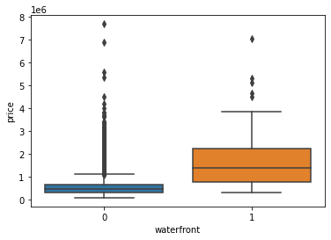
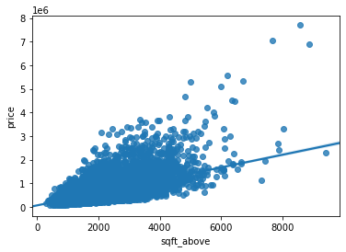
Module 3: Exploratory Data Analysis
Count the number of houses with unique floor values
Boxplot: Determine whether houses with a waterfront view or without a waterfront view have more price outliers.
Regplot: Determine if the area is negatively or positively correlated with price.

Slide 8

Module 4: Model development
Fit a linear regression model
Predict the 'price' using the feature 'sqft_living’
Predict the 'price' using multiple features:
Floors
Waterfront
Lat
Bedrooms
Sqft_basement
View
Bathrooms
…
Calculate R^2 for both predictions
R^2 | ‘price’
‘long’ | 0.00047
‘sqft_living’ | 0.49285
‘floors’, ‘waterfront’, ‘lat’, ‘bedrooms’, ‘sqft_basement’ ‘view’, ‘bathrooms’, … | 0.65766

Slide 9
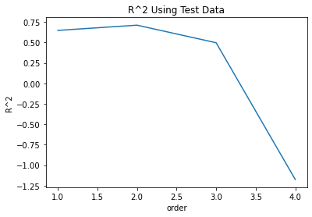
Module 3: Model Evaluation and Refinement
Split the data into training and testing sets
Fit a Ridge regression object using the training data
set the regularization parameter to 0.1
Calculate the R^2 utilising the test data provide
The graph shows how the R^2 changes on the test data for different order polynomials.

Slide 10


Conclusion
This project used linear regression and polynomial regression to
Analyzed the relationship between the independent variable (features of data) and dependent variable (price)
According to the R-squared scores, the house price is influenced by multiple features including the size, the number of bathrooms, and the location.
When the model added more features, the R-squared became higher
There is a need for developing models to test those features and find the ones affecting the housing price the most.

Slide 11
Recommendation
Stakeholders should diversity the Real Estate due to the reason that the price is affected by many factors.
Invests in different types of property to cater for different customers
The results have some limitations:
The dateset only contains one-year data from 2014-2015, may not be accurate to predict the distant future.
There are some factors that are not included in this prediction such as safety index of the district, proximity to amenities, school and hospital. These could be used to further improve the prediction model.

